Slide 1



VISUALIZATION OF NETFLIX DATA
Presented by Teja.Kukatla-AP21110011553

Slide 2
CONTENTS
ABSTRACT
USES OF LIBRARIES
INTRODUCTION
ADVANTAGES
SYSTEM REQUIREMENTS
CONCLUSION
TABLE OF CONTENTS

Slide 3


ABSTRACT
The primary motive of this project is to visualize the data of netflix in graphical representation.
we can also enhance the value of data being utilized through out the project.
In this project I will take a look at some very important models of netflix data to understand what is best for their business

Slide 4
INRODUCTION
we all know that the OTT platforms are ruling the world from the lockdown and netflix is one of the leading streaming service in many countries.
I am aimed to analyze the data using different parameters and present some data visualization using some python libraries
My goal is to design clear visualizations so they are effective and able to highlight important part.

Slide 5
SYSTEM REQUIREMENTS
Hardware requirements :
Software requirements:
Windows 10
Memory-16 GB RAM
Storage-500 GB internal storage
Data set which is a CSV or an EDF file
Jupyter Notebook or Google collab

Slide 6
﻿Table Of Contents
1
Reading and loading a dataset
2
Basic Function
3
Data cleaning
4
Data Filtering
5
Data Visualization

Slide 7
Uses of the Libaries
Numpy: It can be used to Perform Variety of mathematical operations on Arrays.
Pandas: It is used for working with the datasets. It allows us to analyze the data.
Matplotlib: It is an Visualization libary for 2D plots of arrays
Seaborn: It is build up on Matplotlib and used for making statistical garphics in python.

Slide 8
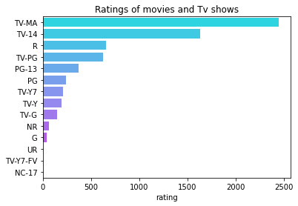
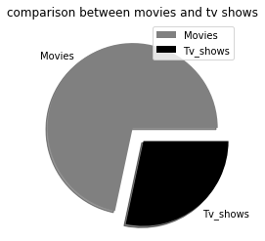

Slide 9
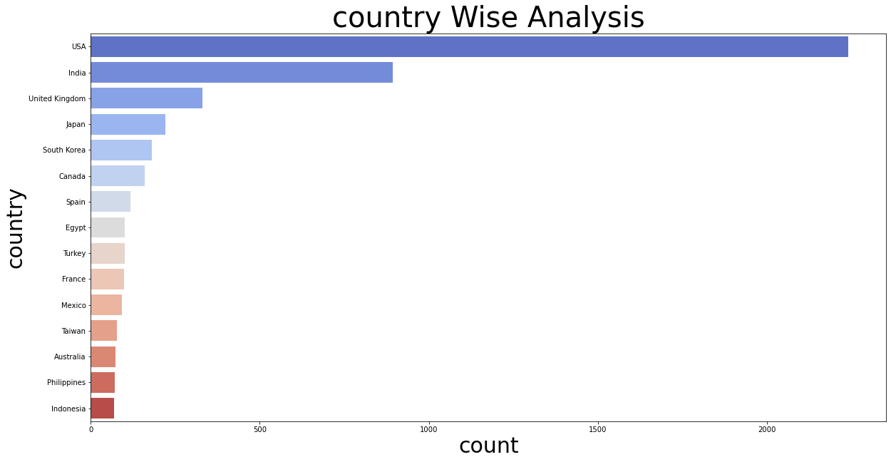

Slide 10
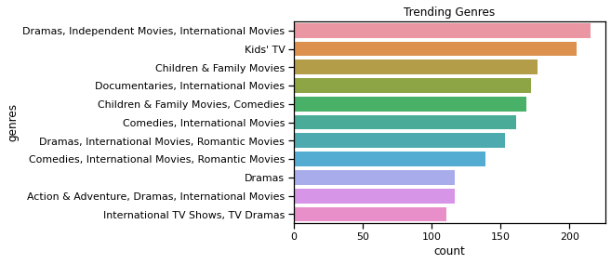

Slide 11

Advantages
This business can increase their market share,revenue growth by utilizing data analytics to gain a competitive advantage over other OTT platforms.
We can analyze and predict what shows/Movies will be popular in the future.
It helps provide better recommendations and improve content selection for users
It Also helps Netflix create Original content that is likely to be successful.

Slide 12
CONCLUSION
This data visualization project is a great way to gain insights and find trends in the ratings of different shows.
By visualizing the data I have discovered interesting patterns.
I am finally excited to see insights about the popularityof different shows on Netflix
Using data visualization can be a great way to present our findings in a clear and engaging manner.

Slide 13
﻿THANK YOU

